Slide 1
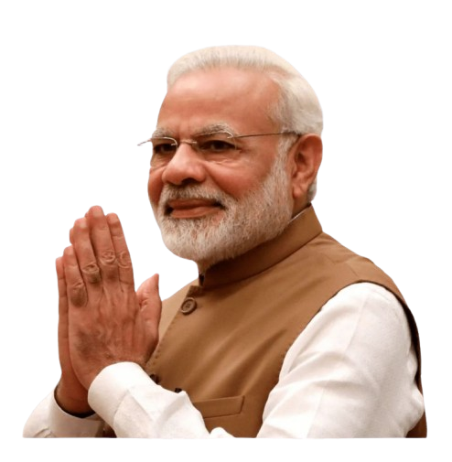
Narendra Modi
Political Activity Dashboard Report

Slide 2

Project Objective
To develop a comprehensive Excel dashboard that offers clear and structured insights into the political journey of Shri Narendra Modi by visualizing key milestones, roles, events, and achievements.
The goal is to enable stakeholders to monitor and analyze major political activities over time through an interactive, user-friendly interface that supports decision-making, historical tracking, and storytelling.

Slide 3


Data Source
The dataset used for this project was generated using Gork AI
Download Data
Google Drive:
Click here to view the dataset

Slide 4
Key Excel Formulas & Features Used
➕ Excel Formula:
1.IF() + ISNUMBER() + LEFT() – Converted text-based outcomes (e.g., “60% Approval”) into numeric values for calculations
2.COUNTA() / COUNTIF() – Used for counting total events and specific categories
📌 Excel Features:
1.Pivot Tables – For calculating KPIs and summarizing event types, roles, and victories
2.Slicers – To allow interactive filtering by event type and role
3.Data Validation – To maintain clean data inputs
4.Charts – Bar, Line, Area, and Pie Charts to visualize political data effectively
.

Slide 5
Key Insights
🔢 Total Political Events Tracked: 289
🔢 National Events: 169
🔢 Policies Launched: 27
🏆 Total Victories: 25
📈 Top Roles: Prime Minister, Chief Minister, RSS Leader
🗓️ Most Active Period: 2014–2019
🎤 Most Frequent Event Type: Public Speeches

Slide 6
Summary
📝 The data indicates a highly active and impactful political phase post-2014, marked by frequent national events, leadership roles, and consistent electoral victories.

